Slide 1

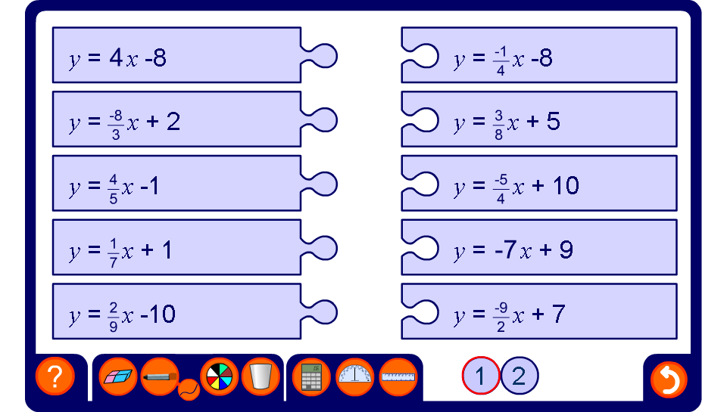


Matching perpendicular lines
Notes:
There are two levels of difficulty for this activity.
Level 1 shows all the line in the form y = mx + c.
In level 2 some of the lines are not in the form y =mx + c and these must be rearranged to find the value of m.

